Slide 1


Offline Health Monitoring and Anomaly Detection for Embedded Units Using Multi-Sensor Telemetry Logs
Context: Ground-Test Telemetry Analytics & Predictive Maintenance
Candidate: Akash Kaushal (MT25MCS016)
Under the Guidance of:
Dr. Ashish S. Tiwari [Assistant Professor]
Department of Computer Science & Engineering
Degree: M.Tech 2nd Year, Computer Science & Engineering

Slide 2

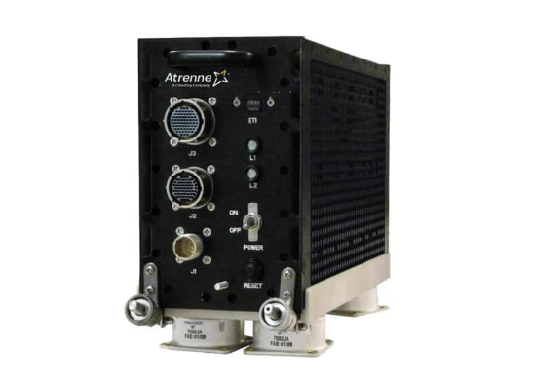
Problem Background: What is an LRU?
→
Line Replaceable Unit (LRU): A ruggedized, sealed edge computer. Contains processors (DSP, FPGA, MCUs), multi-layer PCBs, and switching power supplies. (The smallest self-contained hardware or software assembly that maintenance crew can swap out right at the flight line without extensive disassembly or specialized tools. enclosure used in aerospace.)
→
The Operational Challenge: Runs in unconditioned bays without data-center cooling. Subjected to thermal swings, internal moisture ingress, and high-vibration engine shocks.
→
The Maintenance Gap: Currently relies on fixed schedules or calendar hours. Healthy units get replaced prematurely, while latent physical damage between intervals goes undetected.

Slide 3

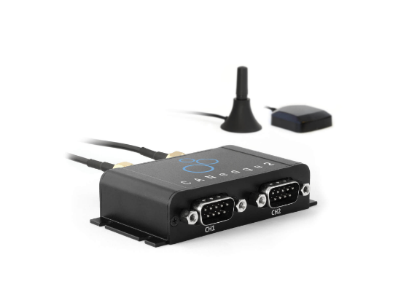
Scope: Ground-Test Offline Log Analysis
Why Offline Ground Analysis?
→
Focuses on post-test ground logs (engine ground runs, taxi tests, environmental stress screenings).
→
Logs are dumped to local memory and extracted via USB/Ethernet after testing.
Key Advantages
→
No strict power/compute constraints of real-time flight controllers.
→
Allows deep multi-domain feature engineering (e.g., high-resolution FFT, spectral wavelets).
→
Enables batch sequence processing and detailed PDF diagnostic report generation.

Slide 4




Data Sources & The Sensors
TI HDC3022DEJR
ADI ADXL314WBCPZ
High-precision digital temperature and relative humidity sensor.
High-g triaxial accelerometer ( ).
→
Monitors: Structural resonance, loose mechanical mountings, landing/taxiing shock transients.
→
Monitors: Internal heating, cooling efficiency, moisture accumulation, dew-point proximity.
→
Rate: Low frequency (~0.2 Hz to 1 Hz).
→
Rate: High frequency (bursts up to 1 kHz).

Slide 5
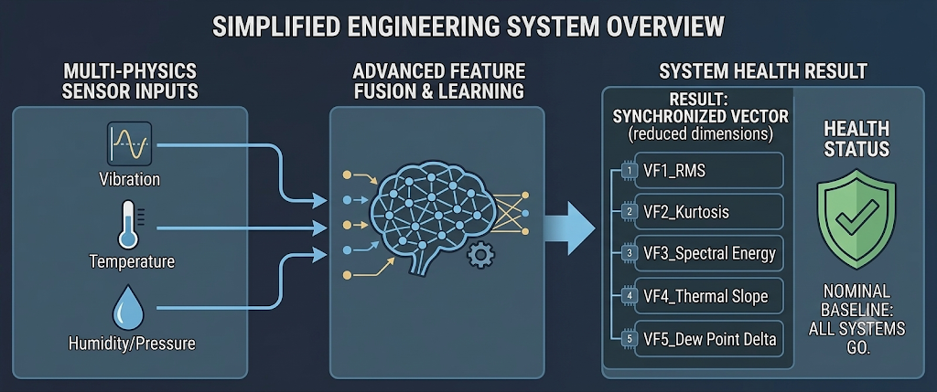
The Computer Science Problem
→
1. Asynchronous Multi-Rate Data Fusion:
•
Vibration logs produce thousands of points per second; temperature updates once every few seconds.
•
Downsampling acceleration directly smooths out and loses critical high-g shock peaks.
→
2. Unsupervised Learning Setting:
•
In mission-critical aerospace hardware, systems are never run until catastrophic physical failure.
•
There are no labeled 'failure' classes—the model must learn nominal baselines without supervised target labels.
→
3. Non-Stationary Dynamics:
•
Normal operational shocks (e.g., ground bumps) must be distinguished from true hardware degradation.

Slide 6





Proposed System Architecture
Raw Ground Logs
Log Parsing & Sanitization
Missing value handling, calibration
Multi-Rate Feature Engineering
1-second sliding epochs (Vibration: RMS, Kurtosis, FFT | Env: dT/dt)
Unsupervised Learning Model
Baseline ML → Deep TCN Autoencoder
Output Condition Assessment
Anomaly Score Profile | Unit Health Index (1.0 → 0.0)

Slide 7
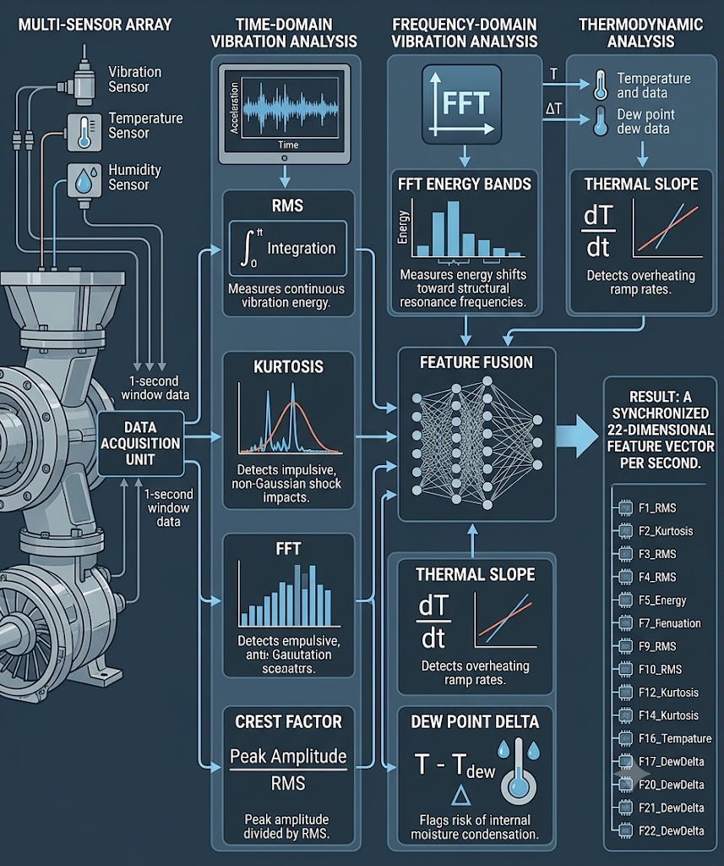
Feature Engineering Pipeline
Multi-Domain Feature Extraction (per 1-second window):
→
Time-Domain Vibration:
•
RMS: Measures continuous vibration energy.
•
Kurtosis: Detects impulsive, non-Gaussian shock impacts.
•
Crest Factor: Peak amplitude divided by RMS.
→
Frequency-Domain Vibration:
•
FFT Energy Bands: Measures energy shifts toward structural resonance frequencies.
→
Thermodynamic Metrics:
•
Thermal Slope ( ): Detects overheating ramp rates.
•
Dew Point Delta ( ): Flags risk of internal moisture condensation.
Result: A synchronized 22-dimensional feature vector per second.

Slide 8

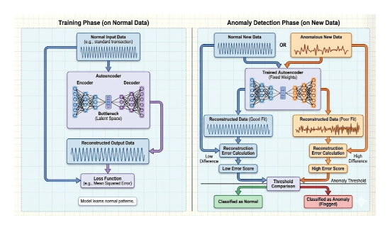


Modeling Methodology: Unsupervised Autoencoders
Core Concept: Reconstruction
→
The model is trained only on verified, normal ground-run logs.
→
Learns normal temporal coupling between temperature, humidity, and vibration.
→
Anomaly Metric: Nominal inputs yield low reconstruction error. Abnormal runs yield high error.
Progression
→
Phase 1: Classical baselines (Isolation Forest, One-Class SVM, PCA).
→
Phase 2: Deep Temporal Convolutional Autoencoder (TCAE) with causal convolutions.

Slide 9

Two-Phase Project Milestones
Phase 1 (Semester III)
Phase 2 (Semester IV)
Data Pipeline, Features & Baselines
Data Ingestion & Sanitation: Develop robust scripts for HDC3022 & ADXL314 raw log extraction and handle missing values.
Feature Engineering: Extract FFT spectral bands and align multi-rate statistical features.
Baseline Benchmarking: Train and evaluate classical unsupervised models (Isolation Forest, One-Class SVM).
Deliverables: Stage-I Progress Report and baseline performance benchmark.
Deep Models, Health Index & Packaging
Deep Learning Architecture: Build, train, and optimize the Temporal Convolutional Autoencoder (PyTorch).
Health Index Engine: Implement the cumulative scoring mechanism and test against synthetic fault injections.
Tool Packaging: Wrap the pipeline into an offline desktop diagnostic tool and finalize academic publications.
→
→
→
→
→
→
→

Slide 10

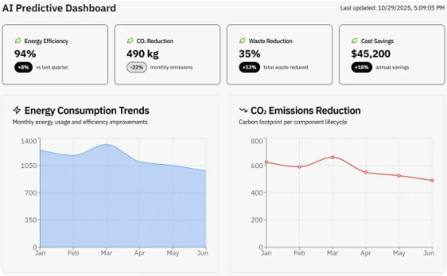
Expected Deliverables & Evaluation
Deliverables
→
Offline Diagnostic Tool: Python-based GUI/CLI application generating automated health reports from test logs.
→
Trained Weights & Pipeline Code: Documented feature extraction and pre-trained neural network models.
→
M.Tech Dissertation & Publication: Academic paper targeted at an IEEE/ACM applied computing conference.
Evaluation Metrics
→
Reconstruction accuracy (RMSE, MAE on nominal test runs).
→
Fault detection rate (Precision, Recall, F1 on synthetic stress & fault-injection logs).
→
Processing speed (target: process a 1-hour ground test log in ).

Slide 11
References
P. Malhotra et al., "LSTM-based Encoder-Decoder for Multi-Sensor Anomaly Detection," ICML Workshop on Machine Learning for Anomalies, 2016.
S. Bai, J. Z. Kolter, and V. Koltun, "An Empirical Evaluation of Generic Convolutional and Recurrent Networks for Sequence Modeling," arXiv:1803.01271, 2018.
K. Hundman et al., "Detecting Spacecraft Anomalies Using LSTMs and Nonparametric Dynamic Thresholding," Proceedings of the 24th ACM SIGKDD International Conference on Knowledge Discovery & Data Mining, 2018.
Texas Instruments, "HDC3022 High-Accuracy Digital Relative Humidity and Temperature Sensor Datasheet," 2021.
Analog Devices, "ADXL314 $±200\text{g}$16-Bit Digital Accelerometer Datasheet," 2020.
F. T. Liu, K. M. Ting, and Z. H. Zhou, "Isolation Forest," IEEE International Conference on Data Mining (ICDM), 2008.

Slide 12
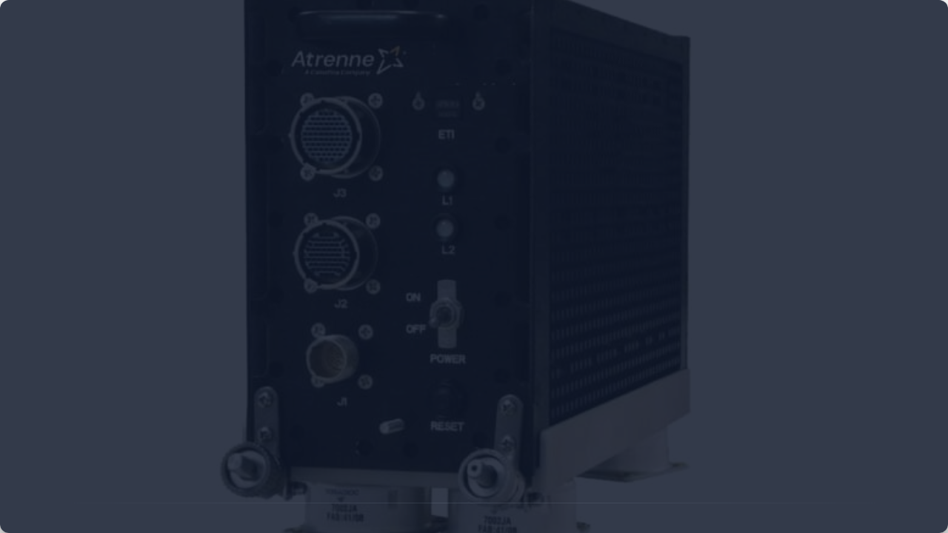
Questions?
Thank you for your attention.

